Slide 1
Grassroots Advocacy 101
Dillon Harp
Grassroots Organizer
American Counseling Association

Slide 2
Presentation Agenda
What is grassroots advocacy?
Why is this important to me?
Is it an effective agent of change?
How to PROPERLY advocate!
ACA’s recent advocacy successes and future advocacy projects

Slide 3
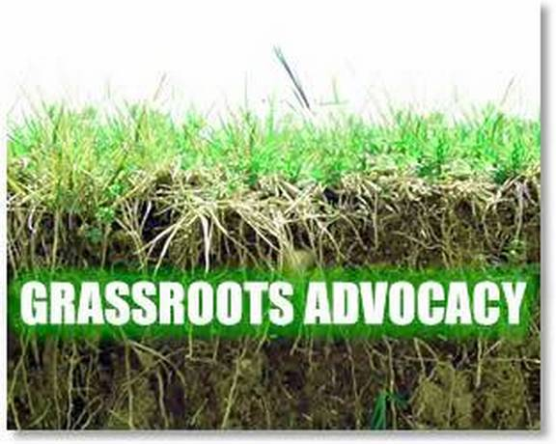
What is Grassroots Advocacy?
Merriam-Webster defines “grassroots” as “the ordinary people in society or organization”¹
Merriam-Webster defines “advocacy” as “the act or process of supporting a cause or proposal”
Notes:
Show the connection between these two words
That is something that US!!! Everyday citizens can do
There is no right or privilege attached to this

Slide 4
History of Grassroots Advocacy
The earliest reference to “grassroots advocacy” came in 1907. When an Oklahoma newspaper stated that Chairman Perry’s platform was one “For square deals, grassroots representation, and for keeping close to the people”

Slide 5
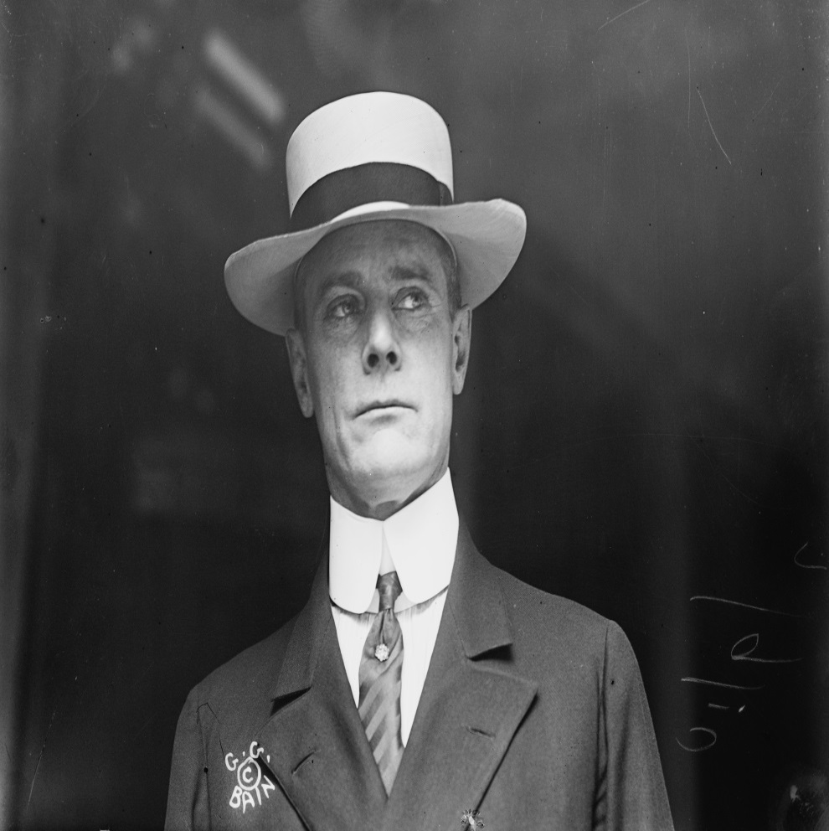
History of Grassroots Advocacy
Senator Albert Jeremiah Beveridge is credited with coining the phrase when he referred to the 1912 Progressive Party “As the party that has come from the grass roots. It has grown from the soil of people's hard necessities".
Notes:
Reference that this is a movement of the people by the people.

Slide 6
What Grassroots Advocacy Looks Like
Notes:
Face to Face Meetings
Email writing

Slide 7
Why is Grassroots Advocacy Important?
We are blessed to live in a society where we have the ability to be the agents of change
Various pieces of legislation and decisions are made everyday that will either negatively or positively impact your life!
By NOT getting involved; you are letting other people make decisions that can drastically change your life
YOU HAVE TO BE THE CHANGE

Slide 8
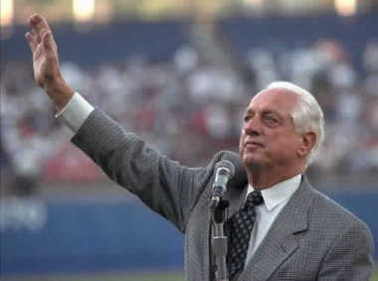
BE THE CHANGE! MAKE IT HAPPEN!
“There are three kinds of people in this world: people who make it happen, people who watch what happens, and people who wonder what happened.”- Tommy Lasorda
BE THE TYPE THAT MAKES IT HAPPEN!

Slide 9
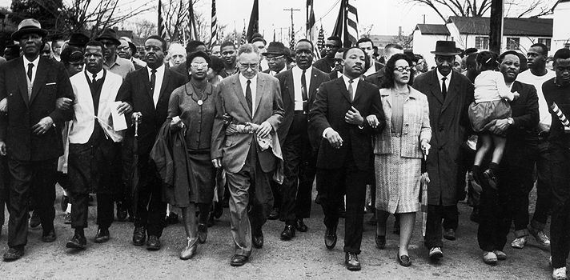
Well Does It Work?
Yes

Slide 10
Does It Work?
Taylor Branch in his book on the Civil Rights Movement wrote that “The Civil Rights Movement from 1945-1968 consisted of grassroots civil rights movements”
The Book “Reported Historical Statistics of the United States, Volume 5: Governance and International Relations,” states that following the year 1955 “That Dr. King was launched to the forefront of grassroots, which profoundly changed American Life”

Slide 11
Why Does It Work?
The Number 1 reason why grassroots advocacy works is due to the fact that we live in a country where we elect our Representatives every 2 years, our President every 4 years and our Senators every 6 years
Notes:
Each politician in the United States is essentially up for a performance review every 2,4, or 6 years.
You decide if they keep their jobs or not
Politicians are always thinking how will my actions today impact my chances of getting reelected
If you are active and engage your politicians then they will listen to you.

Slide 12
Why Does It Work?
Each politician in the United States is essentially up for a job review every 2,4, or 6 years.
You decide if they keep their jobs or not
Politicians are always thinking how will my actions today impact my chances of getting reelected
If you are active and engage your politicians then they will listen to you!

Slide 13
How To Properly Advocate (What To Do Before Hand)
Become familiar with issues that you are interested in
Familiarize yourself with your elected politicians
Know your audience and what the proper channels of communication are
Notes:
3. Gone are the days of letter phone calls and fax machines.
These have been replaced with emails and face to face meetings

Slide 14
How To Properly Advocate
Notes:
In your opinion, how important are the following for understanding
constituents' views and opinions? ⁸

Slide 15
How To Properly Advocate
At all Times be professional and courtesy
Be Knowledge about your issue
The Number 1 thing to remember is TELL YOUR STORY
Notes:
Facebook, Twitter, Vine
Expound on importance of storytelling

Slide 16
Recent/Future Advocacy Efforts
ESSCP Funding
Tricare/ CACREP
Medicare Reimbursement

Slide 17
New Advocacy Projects For FY 16
Social Media
Webinar/Podcasts
Coffee/sit downs
Your Ideas

Slide 18
Questions
dharp@counseling.org
703-823-9800 ext.202

