Slide 1
Growing Counseling in a Rural State Full of Diversity
Stacey Meehl, PsyD,LPCC,NCC,CCMHC
President-Elect
North Dakota Counseling Association

Slide 2
North Dakota is Diverse
as its seasons.

Slide 3
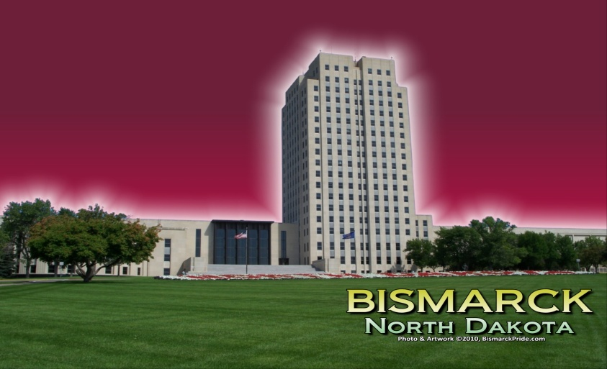
North Dakota is diverse in their communities.

Slide 4
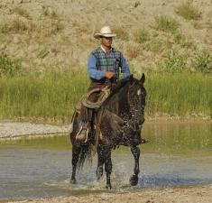
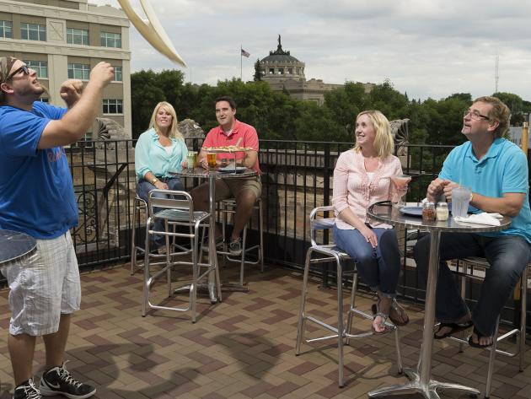
North Dakota is diverse in their culture.

Slide 5
State of North Dakota – Land of Diversity
68,976 square miles – 53 counties –
90 % of the land is farm use

Slide 6
Population of North Dakota
Total Population – 739,482 (2012)
* Largest City Fargo 109,749 (2012)
49% Male
51% Female
90% White
5% Native American
2% Hispanic
1% African American
1% Asian

Slide 7
Counseling in the State of North Dakota

Slide 8
Counseling Education
Universities that Offer Counseling in the state
Schools offer mental health (community) and school counseling
University of North Dakota
North Dakota State University
University of Mary
Moorhead State University (MN)
Northern State University (SD)

Slide 9
North Dakota Counseling Licensure
Licensure is obtained through the ND Board of Counselor Examiners
Counseling Licensure Levels – (6/22/15)
Licensed Associate Professional Counselor – 74 ind.
Licensed Profession al Counselor – 192 ind.
Licensed Professional Clinical Counselor – 170 ind.
Supervision Credentials – 45 ind.
School counselors do not need to be licensed.
The state of ND requires them to be credentialed in school counseling. Only mandate in schools with more than 250 students counselor must be credentialed.
The number of counselors in each school is based on enrollment in the school.
There are present 1,327 schools in the state (PK-12)

Slide 10
North Dakota counseling Association
Established 59 years ago.
Governing board is made up of representative from each division (number of representatives to the board based on division membership), ex officio members, and representatives from university counseling programs.
5 divisions are part of NDCA.
*School Counselors Association (NDSCA)
*Mental Health Counselor Association (NDMHCA)
* Career Development Counselor Association (NDCDA)
* Employment Counselor Association (NDECA)
* Association of Counselor Education Supervisors (NDACES)

Slide 11
North Dakota Counseling Association
Membership (as of 6/15/2015)
Total State Membership - 396 members - slight decline of 24 members over past 5 years total
Division Membership – Many have dual memberships
NDSCA – 235 members
NDMHCA - 67 members
NDCDA - 76 members
NDECA – 10 members
NDACES – 30 members
NDSSWA - disbanded in 2014 due to low numbers

Slide 12
North Dakota Counseling Association
Annual Midwinter Conference
Held annually in February in Bismarck
Held in Bismarck due to central location and available space
Conference is generally held Sunday – Tuesday
NDSCA and NDMHCA hold a preconference on Saturday. The preconference for the past two years has been held jointly together. They have average between 100-130 attendees.

Slide 13
North Dakota Counseling Association
Annual Midwinter Conference
The conference allows up to generally 15 CEU’s.
The conference has in the past brought in nationally known speakers. This year Dr. Jeffrey Kottler is a keynote speaker.
Numerous breakout sessions are provided. Breakouts are conducted by NDCA members and other professionals in the community. The number of sessions offered is based on submitted and accepted proposals to present.

Slide 14
North Dakota Counseling Association
Annual Midwinter Meeting
Division meetings are held. They conduct their business meetings and yearly elections are held of new officers.
Last conference has an attendance of 288 NDCA members. Attendance numbers vary. Weather, days of the week, school holidays, and sporting events.
Attendance in past 5 years:
2011- 324 2013- 315
2012- 309 2014- 310
2015- 288

Slide 15
North Dakota Counseling Association
Communication - State
State association has website that is regularly updated with latest information.
State Website: www.ndcounseling.org
Quarterly Newsletter (FOCUS) is posted on the website.
Membership and Conference registrations are available with electronic payments.
Links are available to all division websites, ACA, and other professional websites.

Slide 16
North Dakota Counseling Association
Communication - State
State has created a Facebook page to help update members on information. 108 likes so far on the page. This site is updated regularly.
Twitter account was created to keep up with current trends in networking.

Slide 17
North Dakota Counseling Association
Communication - Divisions
NDSCA – has a fully updated website to keep in contact with members. They also utilize a list serve to maintain contact with members. They also maintain a Facebook page. They have a newsletter and submit to the state newsletter.
NDSCA website http://www.ndsca.org
NDMHCA – has a fully update website to keep in contact with members. They also maintain a Facebook page. They have an annual newsletter, plus also submit articles quarterly to the state newsletter quarterly.
NDMHCA website http://www.ndmhca.org
The other divisions do not have a website but they maintain contact with members via emails and submitting articles to the state newsletter on regular basis.

Slide 18
North Dakota Counseling Association
Issues with Membership Diversity
Maintaining communication among the members.
Conducting board meetings on a regular basis without the high cost of travel.
Travel to any part of the state to promote membership at universities, meetings, or division meetings.
Growing membership in all division areas. There are many counselors in all areas of counseling that are not member of the association. Connecting with those that are not members can be a struggle.
Providing a conference that meets the needs of all counseling professionals. There is so much diversity among education, practice settings, and experiences to meet all of their needs.
Trying to obtain leadership in the various different areas of counseling across the state.

Slide 19
North Dakota Counseling Association
Present Solutions to Diversity
Utilize that state distance education facilities to hold board meetings. Free service that is available.
Divisions are holding more conferences beyond the Midwinter Conference.
Specialized sessions are being brought into to meet the needs of not only licensure but specialized groups.
Ethics, supervision, private practice, new education regulations, new school testing
Trying to get out more to those sites and universities to gain more membership by utilizing present members within the community. Specifically looking at board members.
Develop committees to meet the needs of the state and make sure that the committees meet regularly to follow through with their plans.
Make sure all websites are updated regularly along with Facebook and Twitter.

Slide 20
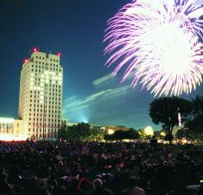
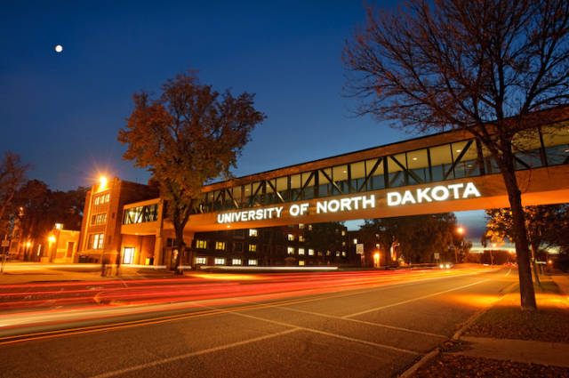
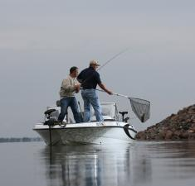
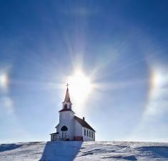
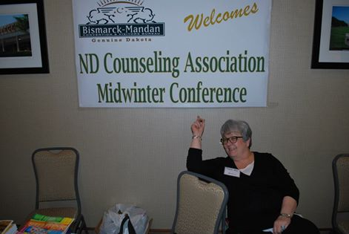
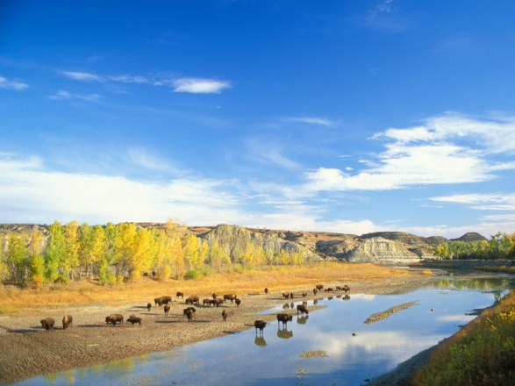
Counseling in North Dakota is as Diverse as North Dakota.

